Slide 1
Diagramming Features as Processes
Activity Diagrams

Slide 2
Overview
After Use Cases
Describe features represented by Use Cases will play out
Activity Diagrams
Sequence of actions that leads through completion of task
Useful analysis tool
Bridge from analysis to design
Actually first step
Similar to flowcharts
Finite set of actions
Serial or parallel

Slide 3
Elaborating on Features as Processes
A Journey toward Code
OO A&D
High level problem space to low level solution
Problem domain to solution domain
UML
Language for capturing & describing our understanding as we make this move
From concept to design
Use Case
Capture things that describe problem
Activity diagram
Solve problem
Match employers to potential employees
Use Case: manage listing
Next step: describe how we manage listing

Slide 4
Elaborating on Features as Processes
Understanding Activity Diagram uses
Not about methods and classes
Too early for that
Capture understanding of domain experts
What does it tell us
Do we understand problem ?
Has it been decomposed sufficiently?

Slide 5
Activity Diagrams
Activity
Something an object performs on an ongoing basis
Can be decomposed into other activities
Action

Slide 6
Using Activity Diagram Symbols
Activity Diagrams
Simple flowchart
Finite beginning and end
Complex diagrams
Model parallel behavior
Multiple sub-flows
Multiple terminuses
Better comprehensible diagram than comprehensive diagram
Diagram what is critical to solving problem
Not necessary for every case
CRUD cases
Very well understood

Slide 7

Using Activity Diagram Symbols
Initial node
One per diagram
Solid circle
One transition line exiting the node
Control flow
Directed arrow pointing away from node
Control Flow
Directed arrow
Flow or edge
Begins at symbol losing focus points to and connects to thing gaining focus

Slide 8
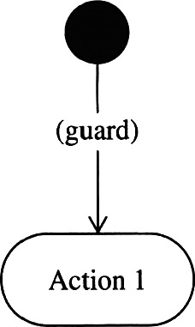
Using Activity Diagram Symbols
Guard Conditions
Shown as text between left and right square brackets
Gatekeeper to the next node
A test which must be passed to continue

Slide 9
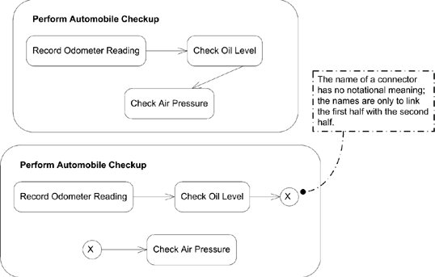
Using Activity Diagram Symbols
With connector
Without connector

Slide 10
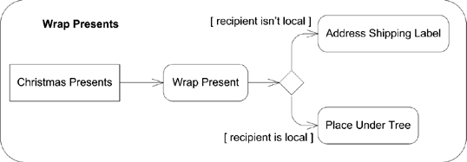
Using Activity Diagram Symbols
Decision node
Branch
Different output flows based upon a Boolean expression
Merge
Two or more branched paths come together

Slide 11
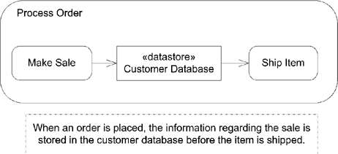
Using Activity Diagram Symbols
Data store node

Slide 12
Using Activity Diagram Symbols
Actions
Things that are done or happen
Edge
Path followed from one action to another
Names
Short
Use nouns and verbs
Multiple incoming flows
Transition cannot occur until all incoming flows have arrived
Single outgoing flow

Slide 13
Using Activity Diagram Symbols
Naming actions
Noun and a verb
Email customer
Cancel listing
Adding preconditions and post conditions
Added using a note
<<precondition>>
Must be true prior to action being invoked
<<postcondition>>
Attached to the action to which it applies

Slide 14
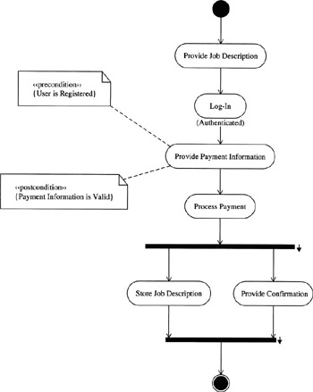
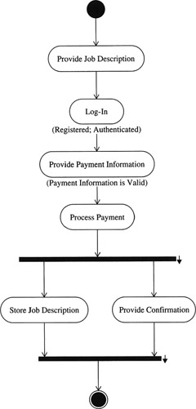

Slide 15
Using Activity Diagram Symbols
Modeling Subactivities
Simplify diagram
Allow reuse
Diagrammed elsewhere
May lose focus on original activity

Slide 16
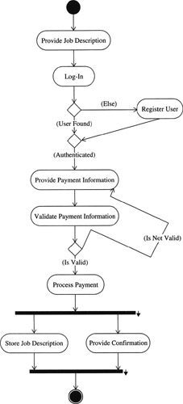
Using Activity Diagram Symbols
Decision and Merge Nodes
Decision
Diamond shape symbol
One edge entering
Multiple edges exiting
Takes only one path
Merge node
Multiple edges entering
Single exiting edge
Doesn’t exit until all flows have arrived
Marks end of behavior started by decision

Slide 17
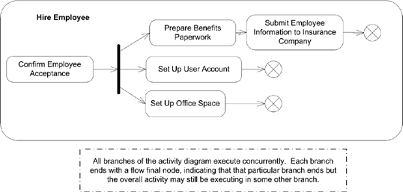
Using Activity Diagram Symbols
Fork node
Splits current flow into multiple concurrent flows
Incoming data is duplicated for each outgoing edge

Slide 18
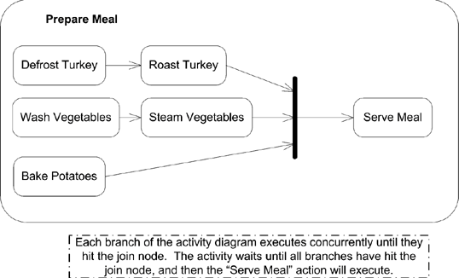
Using Activity Diagram Symbols
Join Node
Multiple flows of an activity into a single flow

Slide 19
Using Activity Diagram Symbols
Transition Forks and Joins
Fork
Exists to depict parallel behavior
Join
Converge parallel behavior into a single flow
Outgoing flow occurs after all incoming flows have arrived
Case does not end until job description is stored and confirmation provided

Slide 20
Using Activity Diagram Symbols
Partitioning Responsibility with Swimlanes
Who is responsible for what part of an activity
Box with name at top
Nodes and edges inside owning box
Can be difficult to organize
2.0
Vertical, horizontal & gridlike
Activity partition

Slide 21
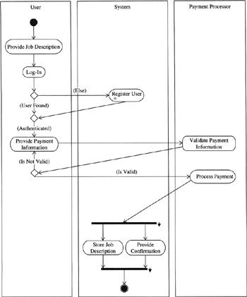

Slide 22
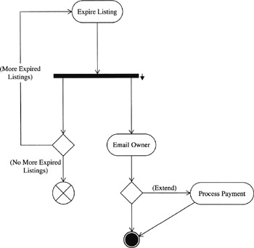
Using Activity Diagram Symbols
Terminating Activity Diagrams
Activity final node
End of activity
Circle with X
Flow final node
End of flow and nothing else happens
Solar Eclipse

Slide 23
Creating Activity Diagrams
What to model
Keep relatively simple
Important, critical or challenging aspects of system
Do not strive for perfection
Better easy to understand and timely
Cannot recoup time spent modeling the obvious
Can always add more

Slide 24
Reengineering Process
Process reengineering
First document a process
Optimize the process
Cabin Check
Make sure ignition switch is off
Turn on master switch so there is power
Lower flaps
Check registration, air worthiness certificate, weight and balance information and operating handbook
Check fuel level indicators and fuel selector
Turn
Master switch off

Slide 25
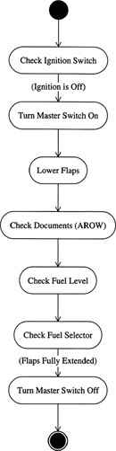
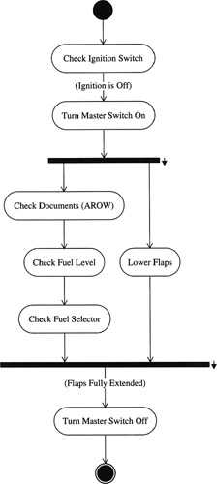

Slide 26
Knowing When to Quit
Do not diagram the obvious
Start with primary functions
Check with domain experts for completeness
Do not get bogged down in details

